Slide 1
Waves
A disturbance that transfers energy from one place to another.

Slide 2
Medium
A material through which a wave travels.
Mechanical Waves = waves that require a medium to travel.
When a medium vibrates mechanical waves are created.
Not all waves require a medium: light waves

Slide 3
How do waves move?
Drop of water – what do you think?
Transferring energy
Duck p. 511
Notes:
Show Bill Nye one for waves, three for sound, and two for light off of UTUBE.

Slide 4
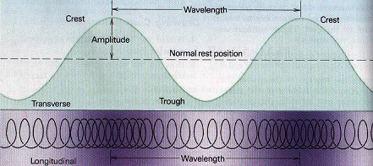
Types of Waves:
Transverse
Longitudinal
Note amplitude, wavelength, and frequency
Speed=wavelength x frequency

Slide 5
Sound
Travels through a medium as a longitudinal wave.
Discuss gong: p.541
Can travel through air, solids, and liquids.

Slide 6
Speed of Sound Depends On:
Elasticity = increase elasticity, increase speed
Density = increase density, decrease speed
Temperature = increase temp., increase speed
Same rules apply to light

Slide 7
Loudness = Amount of energy to make sound and distance from where it came from.
Pitch = Depends on frequency of the wave
Doppler Effect = p. 550

Slide 8
Light

Slide 9
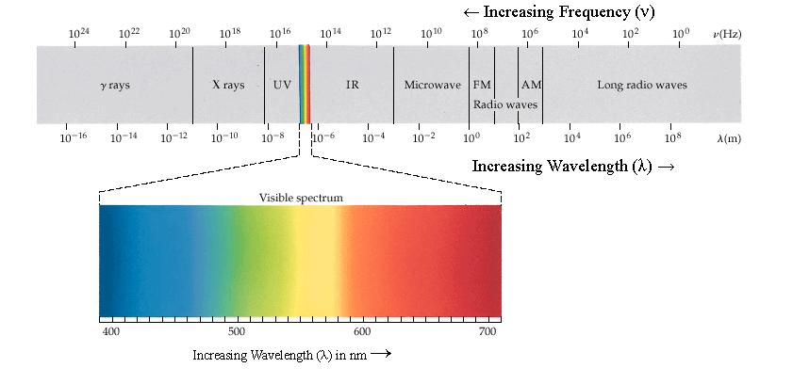
Electromagnetic Spectrum
A transverse wave of electrical and magnetic energy that moves without medium.

Slide 10
Types of waves in the Spectrum:
Radio = radio/T.V. walkie talkies
Micro = cooking, cell phones, radar
Infrared = cooking, heat, cameras
Visible Light = human vision, lights
Ultraviolet Rays = produce vitamin D, cause cancer, sterilization of instruments
X-rays = imagery for the body
Gamma Rays (y) = cancer treatment

Slide 11
How light may strike objects
Refraction – bending from a change in speed.
Reflection – Bouncing back.
Diffraction – Bending around corners.

Slide 12
Visible Light
Colors of the rainbow
Light we see
Red – Long wavelength and low frequency
Violet – shorter wavelength and higher frequency
All light the human eye sees is a color or combination of colors from this spectrum.

